Slide 1
CSI3105: Software Testing
Module 3e: Test Automation In Detail
Notes:
Hi, welcome to the third lecture for CSI3105: Software Testing.
This week we are going to look at Automated testing, manual testing, then finally get our hands dirty and start learning Junit5.
This will allow us to start writing and executing test cases!
Todays slides are a combination from Andrei Ropota, the mandatory text foundations of software testing and the suplimentary test Introduction to software testing. The text, Introduction to software testing has a great chapter on test automation and junit. It is roughly 20 pages long and is a good read.

Slide 2
Ending notes on automated testing
From the Ropota Andrei / Automated Testing slides
Don‘t worry too much about these slides
Refer to these when you are starting your report for the group assignment
Notes:
So lets look at the advantages of automated testing.
Say we work for a company that has a rapid development cycle and we are updating the product of service regularly, we need to continually test to make sure that the new changes do not cause conflict or make the product unstable. If we were using manual testing techniques, a software tester or team would have to conduct the same tests to ensure errors haven’t been introduced. This is repetitive and potentially a waste of resources.
So as regression testing can be automated and tested more frequently, this helps detect errors that reach the productions phase. Because we are using scripts and tools to rest, we can simulate multiple users and do things like load testing and performance testing. This isn’t possible with manual testing. Using frameworks, we are able to write test scrips once and re use them and potentially across different software products with small changes. We can write a test script that takes in various parameters, and continually run this script.
As testing is automated and performed by a computer, the testing cycles are shorter and we can run tests over night. As humans are removed from this part of the testing process, its much easier to estimate how long test are going to run for. Automated testing also automatically compares results, this removes some human error which promotes consistency and results can become more consistent due to more test being run, more often.

Slide 3
Automated testing advantages
Costs and efficiency
Detection of the errors that reached production phase (with regression tests)
Multiple users simulation
Reusable of the old scripts -> creation of the new scripts is reduce
automatic execution of performance tests in the beginning of the production ->less costs for improving the performance
Time economy
quick analysis in case of changing of environment parameters
short duration of the testing cycles
better estimation for test planning
a large number of tests can be executed over night
quick generation of testing preconditions
Quality increase
automatic compare of results
more consistent results due to repeating tests
Notes:
So lets look at the advantages of automated testing.
Say we work for a company that has a rapid development cycle and we are updating the product of service regularly, we need to continually test to make sure that the new changes do not cause conflict or make the product unstable. If we were using manual testing techniques, a software tester or team would have to conduct the same tests to ensure errors haven’t been introduced. This is repetitive and potentially a waste of resources.
So as regression testing can be automated and tested more frequently, this helps detect errors that reach the productions phase. Because we are using scripts and tools to rest, we can simulate multiple users and do things like load testing and performance testing. This isn’t possible with manual testing. Using frameworks, we are able to write test scrips once and re use them and potentially across different software products with small changes. We can write a test script that takes in various parameters, and continually run this script.
As testing is automated and performed by a computer, the testing cycles are shorter and we can run tests over night. As humans are removed from this part of the testing process, its much easier to estimate how long test are going to run for. Automated testing also automatically compares results, this removes some human error which promotes consistency and results can become more consistent due to more test being run, more often.

Slide 4
Limitation of Automated Testing
Most of the times an Automated Testing system can't tell if something "looks good" on the screen or when a pictogram or a window is not displayed well
There are a bunch of problems that can appear when trying to automate the testing process:
Unrealistic expectations (e.g. expectation that automated tests will find a lot of errors)
Poor testing experience
Maintenance of automated tests
Automated testing will never replace definitely the manual testing
Tests that should not be automated are:
tests that are executed very rare
where the system is very unstable
tests that can be verified easily manually but hardly automated
tests that need physical interaction
Notes:
So automated testing sounds great right?
Well automated tests are horrible for things that involve human intervention. An automated test can’t tell if something is actually displaying properly or the end user experience is actually good.
People also have unrealistic expectations with automated testing processes, they expect that automated tests will find lots of errors. If you automate poorly built or thought out tests, it doesn’t matter how many times you run them. Automated testing still relies on good quality software testers. Automated testing software is also expensive and can have a learning curve, this can results in a poor testing experience.
Automated testing will probably never replace manual testing. Realistically before you automate tests, these must be thought up and performed manually at least once.
Tests that are executed rarely, probably aren’t worth the effort the automate. If the system is unstable and prone to crashing, this is probably not worth the effort to build automated tests. Tests that rely on lots of physical interaction and human intervention are probably not worth automating.

Slide 5
Automated testing vs. Manual testing
Pros of Automated testing
If a set of tests must be ran repeatedly, automation is a huge win
It offers the possibility to run automation against code that frequently change to catch regressions
Offers the possibility to add a large test matrix (e.g. different languages on different OS platforms)
Automated tests can be run the same time on different machines, whereas manual tests must be run sequentially
It offers more time for the test engineer to invoke greater depth and breadth of testing, focus on problem analysis, and verify proper performance of software following modifications and fixes
Combined with the opportunity to perform programming tasks, this flexibility promotes test engineer retention and improves his morale
Cons of Automated testing
Costs - Writing the test cases and writing or configuring the automate framework that is used costs more initially than running the test manually.
Some tests can't be automated – manual tests are needed
Notes:
So this one is in the name, if a set of tests must be run repeatedly, automation is a huge win! If your system is constantly changing and you need to run regression tests, the automation of this is a good idea. Remember that regression testing is executing all or a partial selection of tests from the previous build to ensure that no errors have been introduced.
Automated testing also allows for testers to deploy the same tests at the same time on different machine, testing different computers and OS platforms.
As automation frees up testers time, this allows them to think about and deploy a larger breadth of tests and focus more on problem analysis than actually sitting there and manually working through a large series of tests by hand.
A large con of automated testing is the costs for the software. HP’s QTP cost about 10,000 American dollars for once licence. The intial price cost and learning curve may be off-putting.

Slide 6
Automated testing vs. Manual testing (2)
Pros of Manual testing
If the test case runs once or twice most likely is a manual test. Less cost than automating it.
It allows the tester to perform more ad-hoc (random tests). Experience has proven that more bugs are found via ad-hoc (Experience Based Testing) than via automation testing. And more time the testers spends playing with the feature, the greater are the chances of finding real user problems.
Cons of Manual testing
Running tests manually can be very time consuming
The manual tests are requiring more people and hardware
Each time there is a new build, the tester must rerun all required tests - which after a while would become very boring and tiresome.
Notes:
So what are some pro of manual testing?
If a test will not be run that often, its probably not worth automating it and manual testing will be more cost effective.
Manual testing also allows the tester to perform more ad hoc tests. This can be exploratory. If someone is experienced in testing or knows the software under test well, it is probably quicker for the to manually perform a few random tests.
Alternativly, it can be very expenesive for someone to sit there are run many manual tests in succession. This is very time consuming. If every time there is a new build of software and the tester must manually perform all the test, this can become tiresome and the breeds errors and complacency.

Slide 7
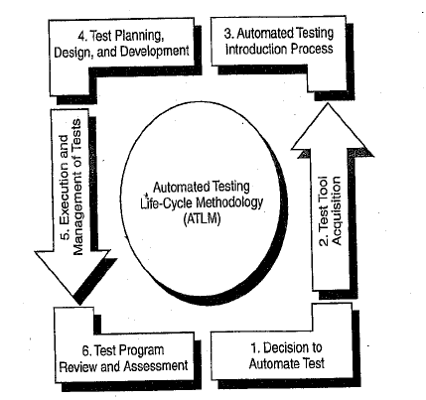
Automated Test Life-Cycle Methodology (ATLM)
Decision to Automate Test
Test Tool Acquisition
Automated Testing Introduction Process
Test Planning, Design and Development
Execution and Management of Tests
Test Program Review and Assessment
Notes:
Now we have talked about automated testing – lets talk about integrating this into your workplace.
By using the systematic approach outlined within the Automated Test Life-Cycle Methodology , organizations can organize and execute test activities in a way that maximizes test coverage within the limits of testing resources. This structured test methodology involves a multi-stage process, supporting the detailed and interrelated activities that are required to introduce and utilize an automated test tool:
Basically organizations can face resource constraints where they are trying to maximize their test coverage, withing the limits of what ever testing resources they have. By following a systematic approach and structure, they can maximize their testing resources. This is why organizations follow automated test life cycle methodologies.
The automated test life cycle methodolody is to
Decision to automate testing - purpose to help overcome false expectation.
Then you must find the right test tool.
Go through the automated testing introduction process. This phase outlines the steps necessary to successfully introduce automated testing to a new project, which are summarized in the following sections
Design and develop the tests
Go through the execution phase
Then review and assess.

Slide 8
Decision to Automate Test: Overcoming False Expectations
REALITY
No tool can create automatically a comprehensive test plan
No single tool can support all operating systems environments and programming languages
Initial use of an automated test tool can actually increase the test effort
Using an automated tool requires new skills, additional training is required
Not all the tests required for a project can be automated (e.g. some test are physically impossible; time or cost limitation)
It is impossible to perform an exhaustive testing of all the possible inputs (simple or combination) to a system
EXPECTATION
Automatic test plan generation
Test tool fits all
Imminent test effort reduction
Tool ease of use
Universal application of test automation
100% test coverage
Notes:
The decision to automate phase has the purpose to help overcome false expectation.
During this phase, it's important for the test team to manage automated testing expectations and outline what to expect and what not to expect. Expecially to management or people who don’t come from a testing background.
We need to decide if we want to automate the tests.
There are some expectations associated with test automation, they are
EXPECTATION
Automatic test plan generation - No tool can create automatically a comprehensive test plan
One Test tool fits all - No single tool can support all operating systems environments and programming languages
Imminent test effort reduction - Initial use of an automated test tool can actually increase the test effort
Tool ease of use - Using an automated tool requires new skills, additional training is required
Universal application of test automation - Not all the tests required for a project can be automated (e.g. some test are physically impossible; time or cost limitation)
100% test coverage - It is impossible to perform an exhaustive testing of all the possible inputs (simple or combination) to a system

Slide 9

Decision to Automate Test: Benefits of Automated Testing
Production of a reliable system | Improved requirements definition Improved performance/load/stress testing Improved partnership with development team Improved system development life cycle
Improvement of the quality of the test effort | Improved build verification testing (smoke testing) Improved regression testing Improved multiplatform/software compatibility testing Improved execution of the repetitive tests Improved focus on advanced test issues Execution of tests that manual testing can't accomplish Ability to reproduce software defects After-hours testing
Reduction of test effort and minimization of schedule
Notes:
So we have decided to pay for some automated testing software and put in the time to learn this stuff,
We should see :
Improved requirements definition
Improved performance/load/stress testing
Improved partnership with development team
Improved system development life cycle
Improved build verification testing (smoke testing)
Improved regression testing
Improved multiplatform/software compatibility testing
Improved execution of the repetitive tests
Improved focus on advanced test issues
Execution of tests that manual testing can't accomplish
Ability to reproduce software defects
After-hours testing
Improved requirements definition: Generation of clear requirements helps the minimization of time and effort

Slide 10
Test Tool Acquisition
Business analysis phase | business modeling tools configuration management tools defect tracking tools
Requirements definition phase | requirements management tools requirements verifiers tools
Analysis and design phase | database design tools application design tools
Programming phase | syntax checkers/debuggers memory leak and run-time error detection tools source code or unit testing tools static and dynamic analyzers
Testing phase | test management tools network testing tools GUI testing tools (capture/playback) non-GUI test drivers load/performance testing tools environment testing tools
Identify which of the various tool types suit the organization system environment, considering:
- the group/department that will use the tool;
- the budget allocated for the tool acquisition;
- the most/least important functions of the tool etc.
Choose the tool type according to the stage of the software testing life cycle
Evaluate different tools from the selected tool category
Hands-on tool estimation – request product demonstration (evaluation copy)
Following the conclusion of the evaluation process, an evaluation report should be prepared
Notes:
So we have management and other onside, How do we choose the right tool?
We need to Identify which of the various tool types suit the organization system environment,
Taking these points into consideration:
- which group/department that will use the tool;
- how much budget is allocated for the tool acquisition;
- the most/least important functions of the tool and choose acoording to this
.
We can also Choose the tool type according to the stage of the software testing life cycle is we are Business analysis phase we could select
business modeling tools
configuration management tools
or defect tracking tools
If we are in the requirements definition phase we could select
requirements management tools
or requirements verifiers tools
If we are in the Analysis and design phase we could select
database design tools
or application design tools
If we are in the Programming phase
syntax checkers/debuggers
memory leak and run-time error detection tools
source code or unit testing tools
Or static and dynamic analyzers
And finally if we are in the Testing phase we can choose
test management tools
network testing tools
GUI testing tools (capture/playback)
non-GUI test drivers
load/performance testing tools
Or environment testing tools

Slide 11
Automated Testing Introduction Process – Test Process Analysis
Process review | Test process characteristics (goals, strategies, methodologies) have been defined and they are compatible with automated testing Schedule and budget allows process implementation The test team is involved from the beginning of SDLC
Test goals | Increase the probability that application under test will behave correctly under all circumstances Increase the probability that application meets all the defined requirements Execute a complete test of the application within a short time frame
Test objectives | Ensure that the system complies with defined client and server response times Ensure that the most critical end-user paths through the system perform correctly Incorporate the use of automated test tools whenever feasible Perform test activities that support both defect prevention and defect detection Incorporate the use of automated test design and development standards to create reusable and maintanable scripts
Test strategies | Defect prevention (early test involvement, use of process standards, inspection and walkthroughs) Defect detection (use of automated test tools, unit/integration/system/acceptance test phase)
Notes:
Process review – What are we going to do, what are our strategies to achieve these goals and how are we going to measure them.
Communicate this to the team.
The process of introducing automated testing to a new project team constitutes the third phase of the ATLM. This phase outlines the steps necessary to successfully introduce automated testing to a new project, which are summarized in the following sections
Test process analysis ensures that an overall test process and strategy are in place and are modified, if necessary, to allow automated testing to be introduced in a successful fashion. The test engineers define and collect test process metrics in order to allow for process improvement.
Here test goals/objectives and strategies need to be defined and test process needs to be documented and communicated to the test team. In this phase, the kinds of testing applicable for the technical environment will be defined, and tests are defined that can be supported by automated tools.
During the test process analysis, techniques are defined. Best practices are laid out, such as conducting performance testing during the unit-testing phase.
Plans for user involvement are assessed, and test team personnel skills are analyzed against test requirements and planned test activities. Early test team participation is emphasized, supporting refinement of requirement specifications into terms that can be adequately tested while also supporting test team understanding of application requirements and design.
Test Tool Consideration
The test tool consideration process includes steps that investigate whether incorporation of automated test tools that have been brought into the company without a specific project in mind now would be beneficial to a specific project, given the project testing requirements, available test environment, personnel resources, user environment, platform, and product features of the application under test. Schedule is reviewed to ensure sufficient time for test tool setup and development of requirements hierarchy; potential test tools and utilities are mapped to test requirements, test tool compatibility with the application and environment is verified, and workaround solutions are investigated for incompatibility problems that surfaced during compatibility tests

Slide 12
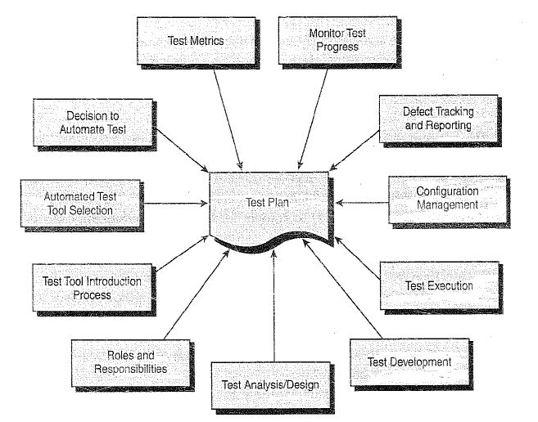
Test Planning
The test planning element of the ATLM incorporates the review of all activities required in the test program
It ensures that testing processes, methodologies, techniques, people, tools, schedule and equipment are organized and applied in an efficient way
Key elements: planning associated with project milestone events, test program activities and test program-related documentation.
The following must be accomplished:
- the technical approach for these elements is developed;
- personnel are assigned
- performance timelines are specified in the test program schedule.
Test planning is not a single event, but rather a process. It is the document that guides test execution through to a conclusion, and it needs to be updated frequently to reflect any changes.
Notes:
The test plan will define roles and responsibilities, project test schedule, test planning and design activities, test environment preparation, test risks and contingencies, and acceptable level of thoroughness (test acceptance criteria)
The test planning stage represents the need to review long–lead-time test planning activities. During this phase, the test team identifies test procedure creation standards and guidelines; hardware, software, and network required to support test environment; test data requirements; a preliminary test schedule; performance measure requirements; a procedure to control test configuration and environment; as well as defect-tracking procedure(s) and associated tracking tool(s).
The test plan contains the results of each preliminary phase of the structured test methodology (ATLM). The test plan will define roles and responsibilities, project test schedule, test planning and design activities, test environment preparation, test risks and contingencies, and acceptable level of thoroughness (test acceptance criteria). Test plan appendices may include test procedures, naming conventions, test procedure format standards, and a test procedure traceability matrix.
The test environment setup is part of test planning. It represents the need to plan, track, and manage test environment setup activities, where material procurements may have long lead times. The test team needs to schedule and track environment setup activities; install test environment hardware, software, and network resources; integrate and install test environment resources; obtain/refine test databases; and develop environment setup scripts and test bed scripts.

Slide 13
Test Design
Black-Box Test Techniques | Automated Test Tools
Random Testing | GUI Test Tools
Regression Testing | GUI/Server Test Tools
Stress/Performance Testing | Load Test Tools
Security Testing | Security Test Tools
Data Integrity Testing | Data Analysis Tools
Configuration Testing | Multiplatform Test Tools
Functional Testing | Load/GUI/Server Test Tools
User Acceptance Testing | GUI Test Tools
Usability Testing | Usability Measurement Tools
Alpha/Beta Testing | Load/GUI/Server Test Tools
Boundary Value Analysis | Develop program code to perform tests
Backup and Recoverability Testing | Load/GUI/Server Test Tools
Notes:
The test design component addresses the need to define the number of tests to be performed, the ways that testing will be approached (paths, functions), and the test conditions that need to be exercised. Test design standards need to be defined and followed.

Slide 14
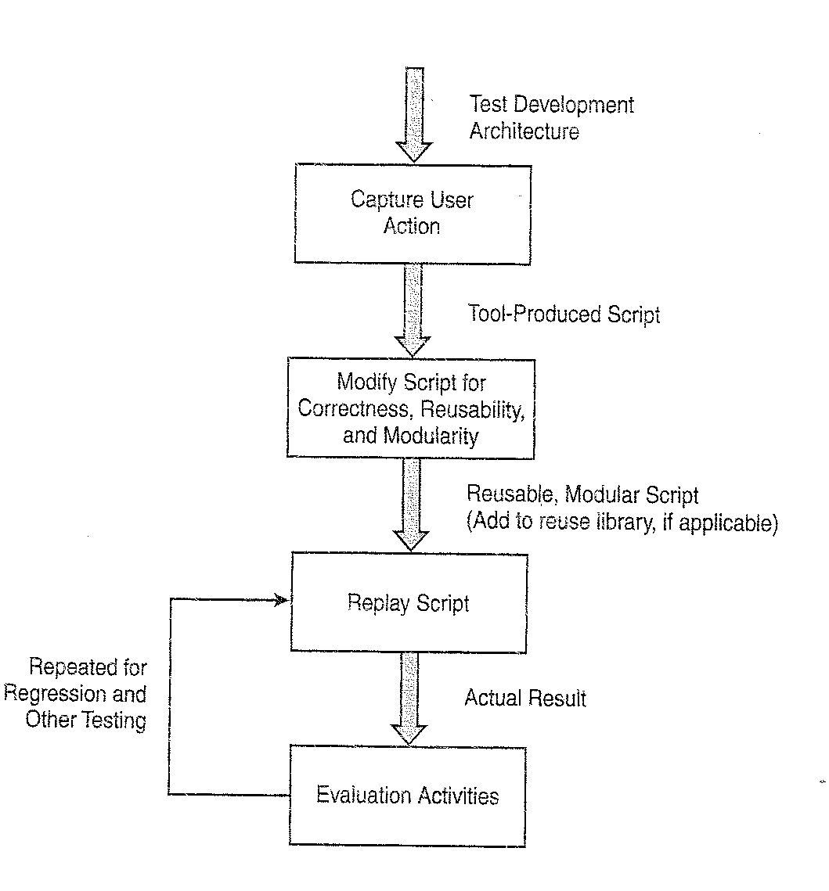
Test Development
Development Guideline Topics | Description
Design-to-Development Transition | Specify how design and setup activities will be translated into test development action
Reusable Test Procedures | Test procedures need to be reusable for highest test program return on investment
Data | Avoid hard-coding data values into scripts
Capture/Playback | Outlines on how to apply the use of capture/playback recording
Maintainable Test Procedures | A test procedure whose defects are easy to remove and can easily be adapted to meet new requirements
Test Script Documentation | Test script documentation is important for test procedure maintainability
Naming Standards | Defines the standard naming convention for test procedures
Modularity | Guidelines for creating modular test scripts
Global Files | Globally declared functions are available to any procedure
Constants | Use of constants in order to support maintainable procedure
Notes:
For automated tests to be reusable, repeatable, and maintainable, test development standards need to be defined and followed.
After performing test analysis and design, the test team is now ready to perform test development.
Keep in mind that the test design and development activities follow an iterative and incremental approach, in order to address the highest risk functionality up front. Table 2 correlates the development process phases to the test process phases. The testing processes and steps outlined in the table are strategically aligned with the development process, and the execution of these steps results in the refinement of test procedures at the same time as developers are creating the software modules. Automated and/or manual test procedures are developed during the integration test phase with the intention of reusing them during the system test phase.

Slide 15
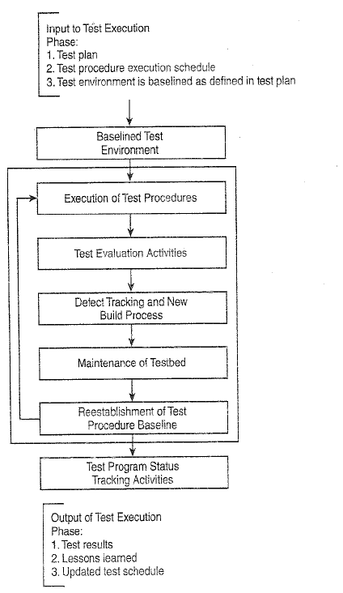
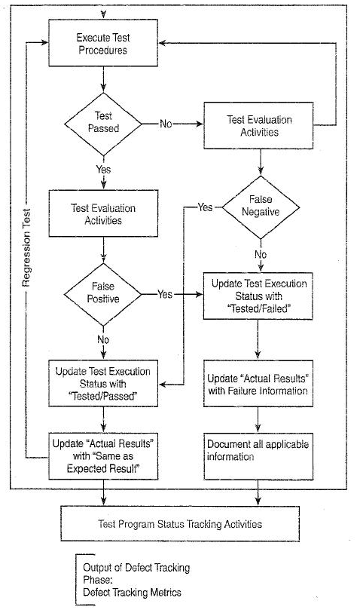
Test Execution
Notes:
At this stage, the test team has addressed test design and test development. Test procedures are now ready to be executed in support of exercising the application under test. Also, test environment setup planning and implementation was addressed consistent with the test requirements and guidelines provided within the test plan.
With the test plan in hand and the test environment now operational, it's time to execute the tests defined for the test program. When executing test procedures, the test team must comply with a test procedure execution schedule, as discussed earlier. The test procedure execution schedule implements the strategy defined within the test plan. Plans for unit, integration, system, and user acceptance testing are executed.
When executing test procedures, the test team needs to comply with a test procedure execution schedule. Following test execution, test outcome evaluations are performed and test result documentation is prepared.

